Slide 1
DiagnoGenie
Diagnostics Laboratory Manager
Submitted by – Team5_Diagnostic Laboratory Manager
Vamsi Krishna Yepuri
Venkata Kalyan Polamarasetty
Jyothi Vasamsetty
Vamshi Krishna Reddy Pasham

Slide 2
Problem Statement
Managing a laboratory involves a lot of tasks such as tracking inventory, scheduling tests, managing lab equipment, and ensuring compliance with safety regulations. This can be a time-consuming and complex process. Inefficient management of a laboratory can lead to wasted resources, inaccurate results, and potential safety risks.
To overcome these challenges, there is a need for a laboratory manager software that can streamline the management of laboratory operations, increase efficiency, and ensure accurate and timely test results.
The key features of DiagnoGenie include inventory management, scheduling and tracking of tests, management of lab equipment, user access controls and permissions, and reporting and analytics for quality control and process improvement. It allows the end users to manage everything electronically, view tasks, and take control of them without having to search for the paperwork again in various protocols and file formats.

Slide 3
How does a current system work?
Operated manually and includes a lot of paperwork
Every appointment is made through a walk-in, a phone call
The lab assistant collects the sample and labels it with the customer's name
The lab technicians test these samples
After the sample has been examined, reports are either printed or sent via email
Reports from the imaging department must be carried physically
All of the inventory is currently tracked manually, and there is no report available on how things are going
Common issues faced with the system?
involves a lot of paperwork
physically storing reports creates a lot of tedious tasks and takes up a lot of space
manually sending reports over email
no proper communication
schedule the appointments
running out of inventory
compliance with security and privacy regulations

Slide 4
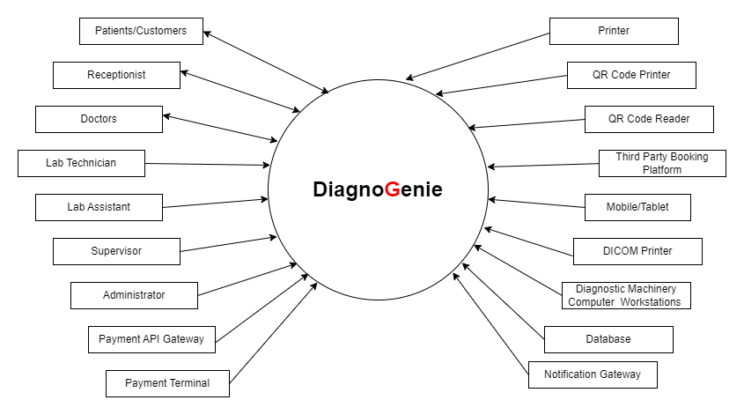
Context Diagram

Slide 5
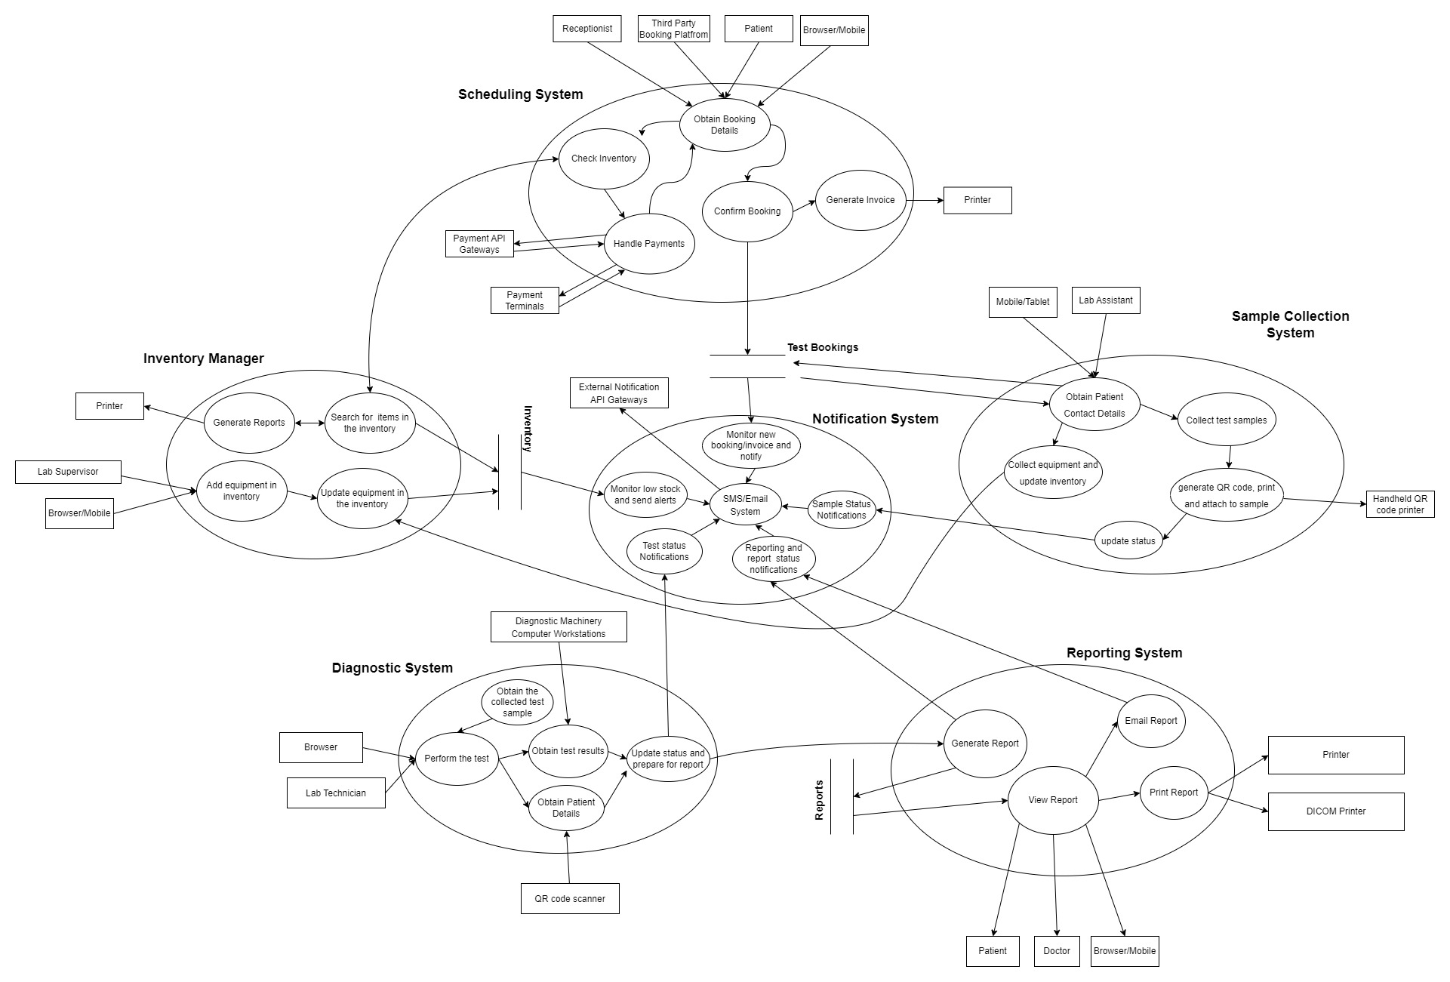
Data Flow Diagram

Slide 6
Use Case Scenarios

Slide 7
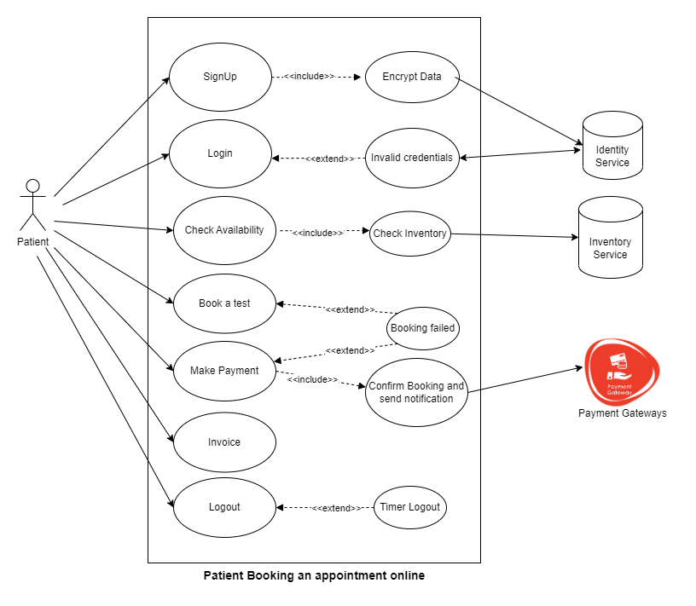
Patient booking an appointment online

Slide 8
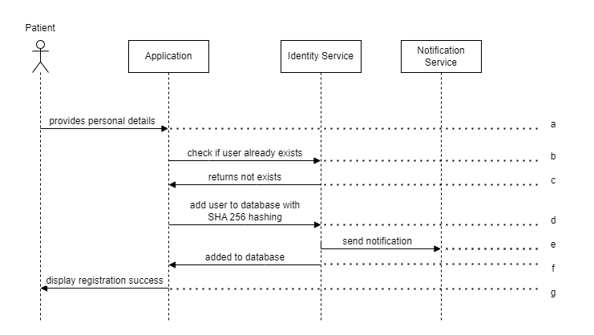
Successful user registration

Slide 9
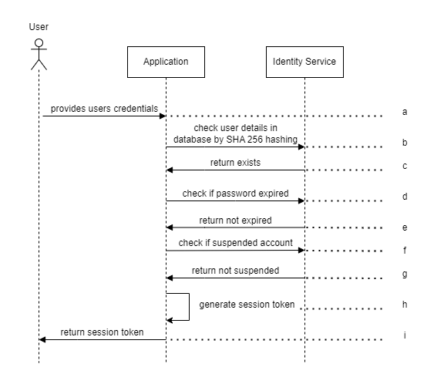
User successful login

Slide 10
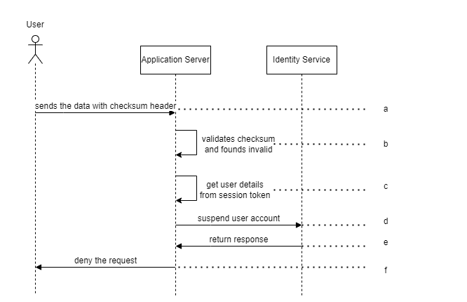
Detecting attack

Slide 11
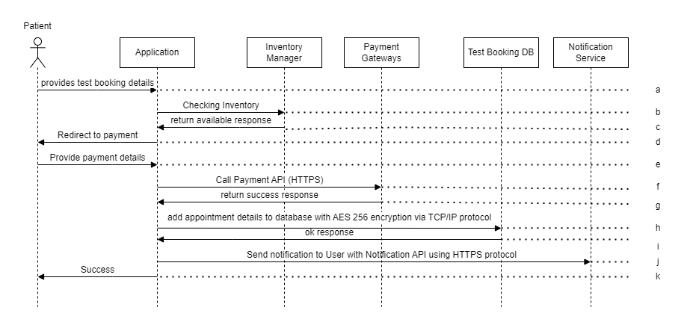
Successful test booking online

Slide 12
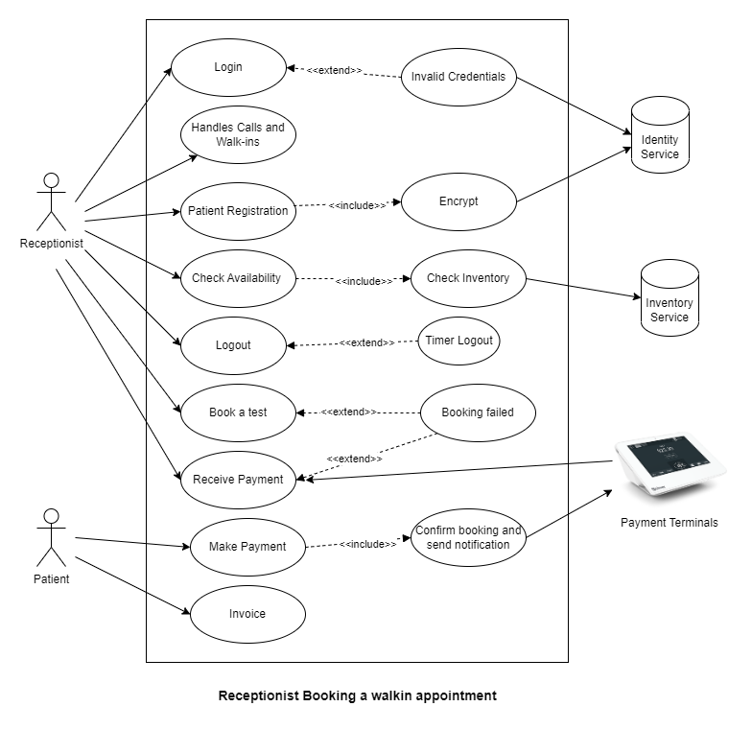
Receptionist booking a walk-in appointment

Slide 13
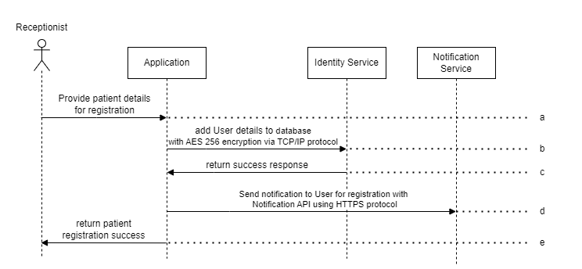
Receptionist registering patient in walk-in appointment

Slide 14
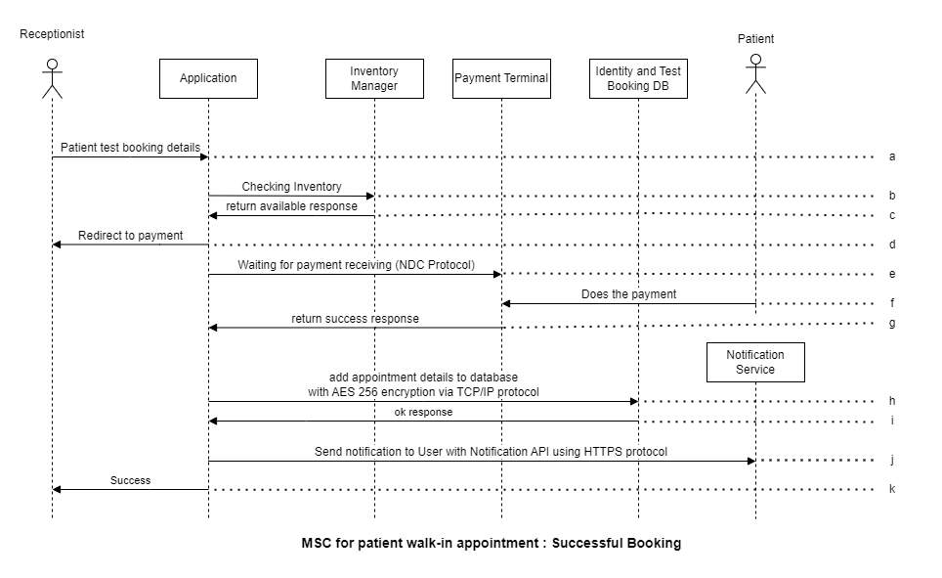
Successful booking of walk-in appointment

Slide 15
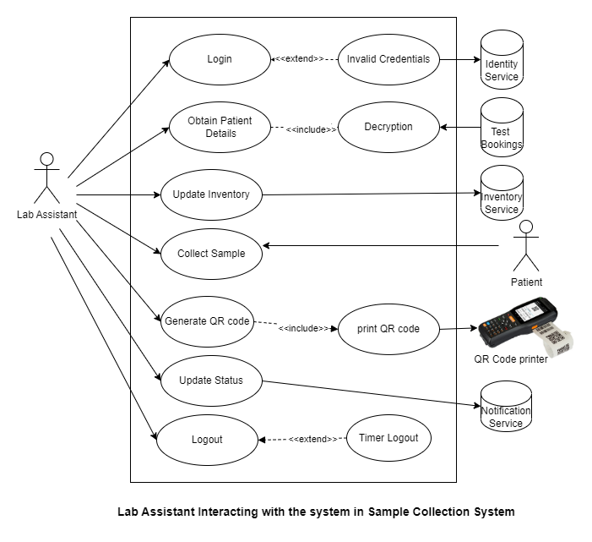
Lab Assistant with sample collection system

Slide 16
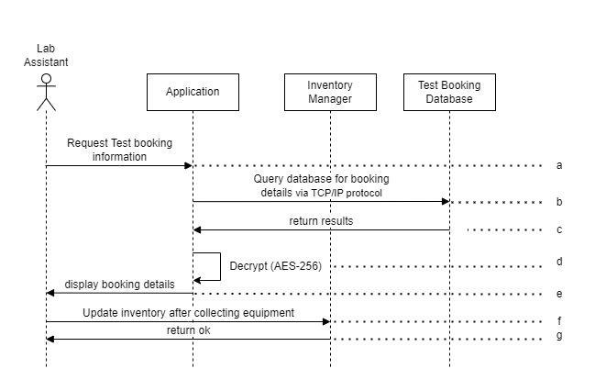
Lab Assistant obtaining bookings and updating inventory

Slide 17
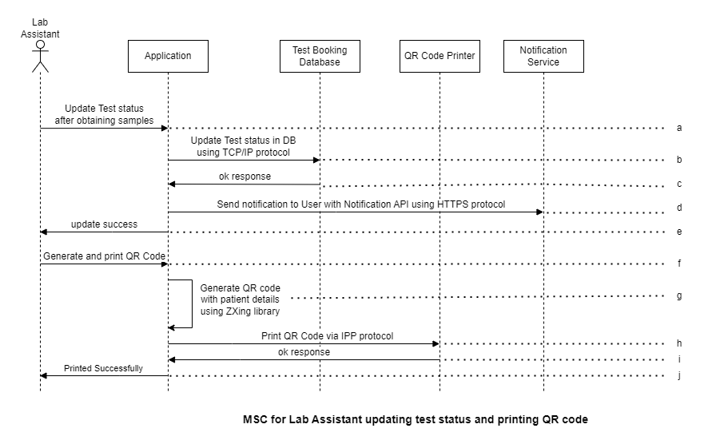
Lab Assistant updating test status and printing QR code

Slide 18
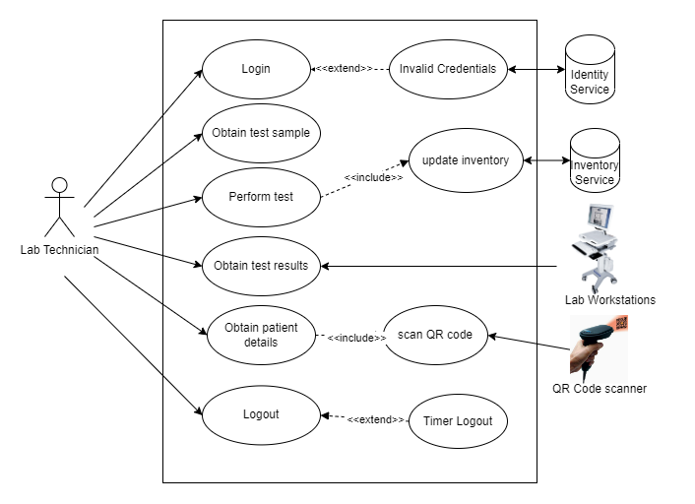
Lab Technician performing the test

Slide 19
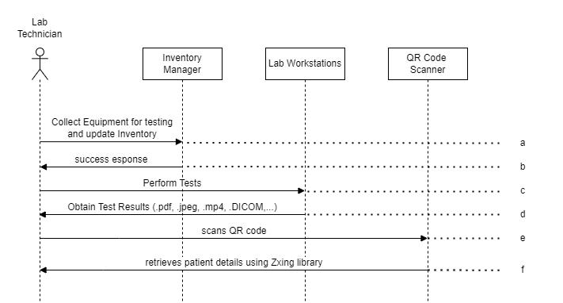
Lab Technician performing test

Slide 20
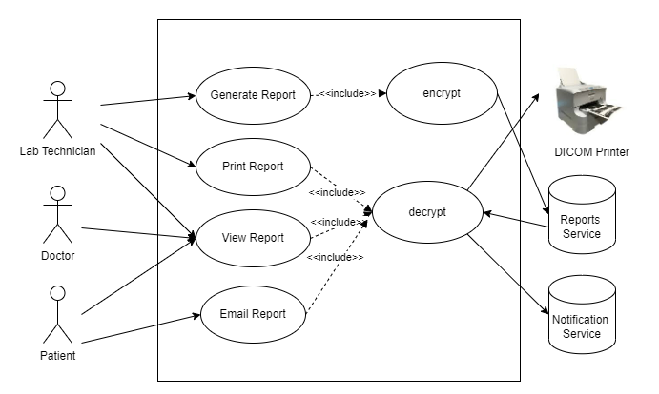
Accessing the report

Slide 21
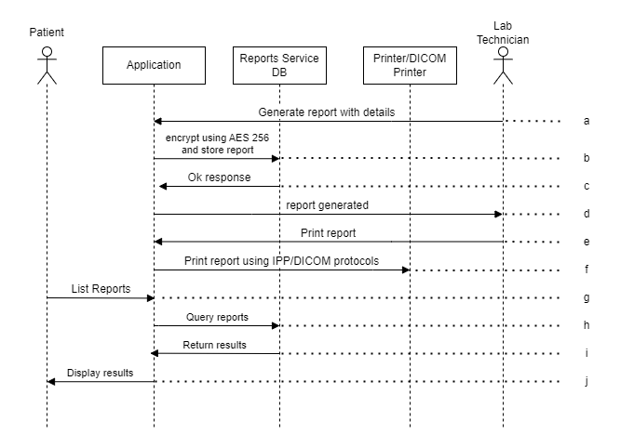
Reports generation and listing

Slide 22
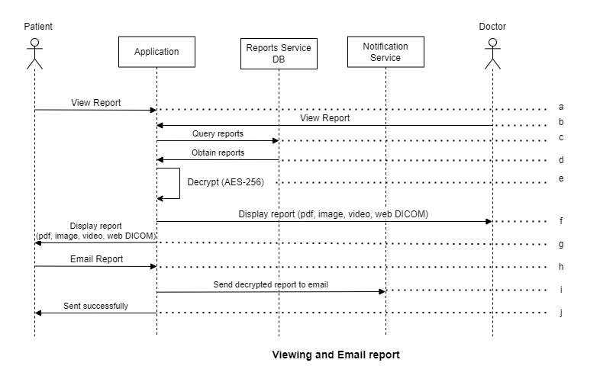
View and Email report

Slide 23
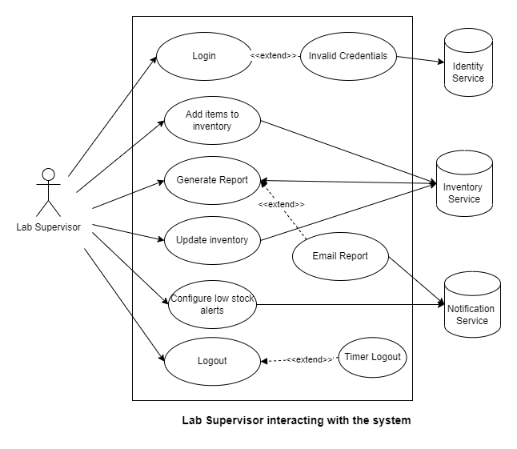
Lab Supervisor interacting with the system

Slide 24
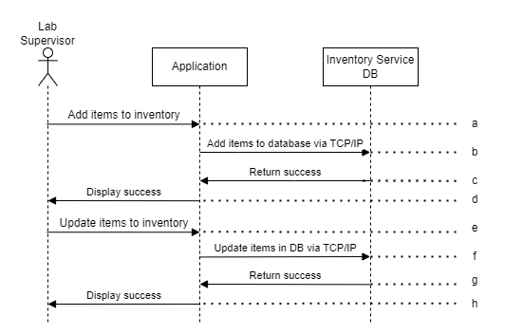
Lab Supervisor managing the inventory

Slide 25
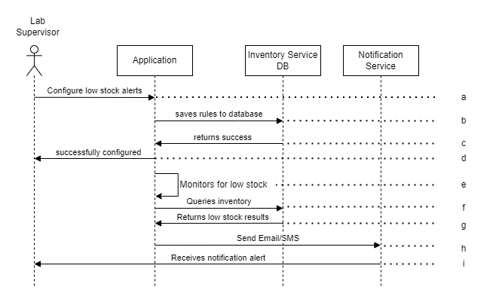
Lab Supervisor configuring monitoring of low stock alerts

Slide 26
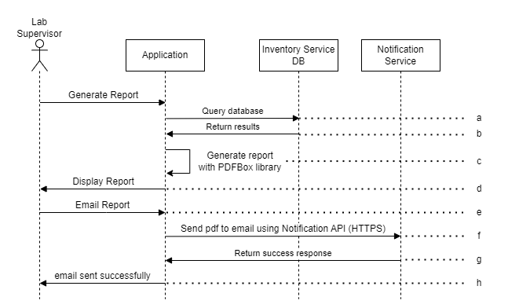
Lab Supervisor report generation and sending e-mail of report

Slide 27
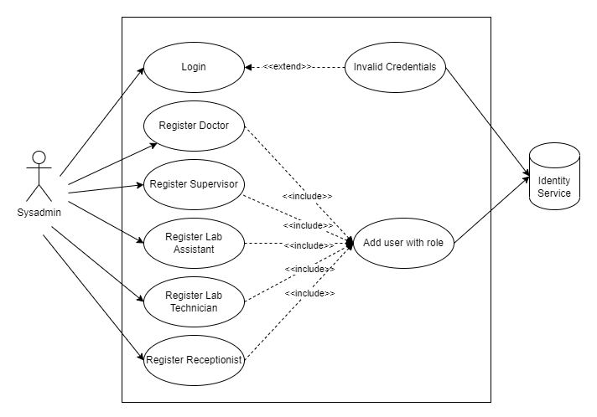
System Administrator providing identity access

Slide 28
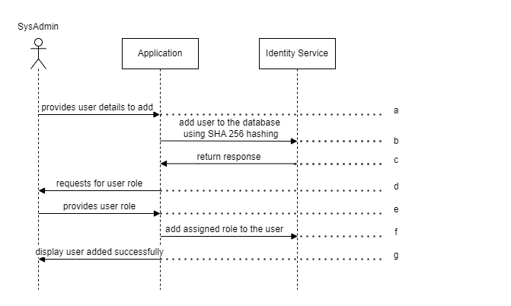
Sysadmin providing user access with RBAC

Slide 29
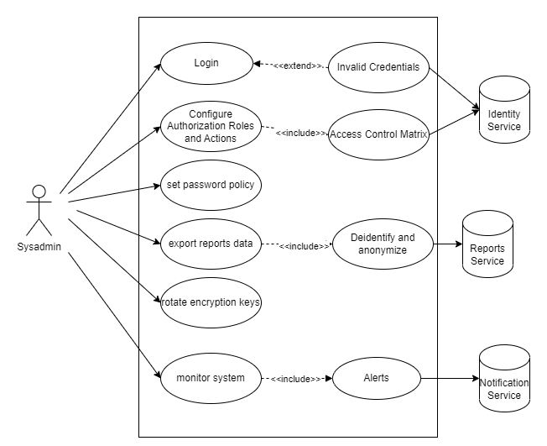
Sysadmin Administration, Maintenance and Security

Slide 30
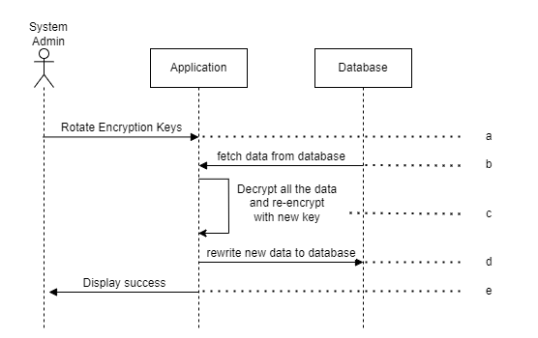
Rotating encryption keys

Slide 31
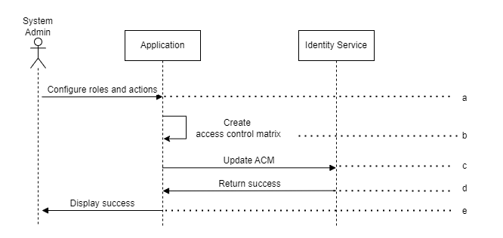
Configuring role and actions

Slide 32
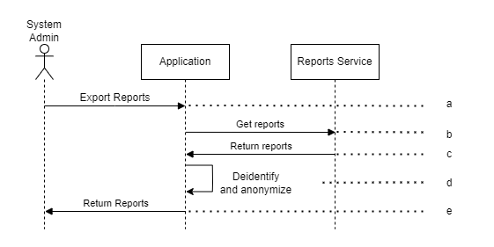
Exporting reports

Slide 33
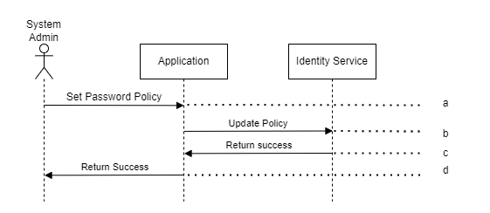
Updating password policy

Slide 34
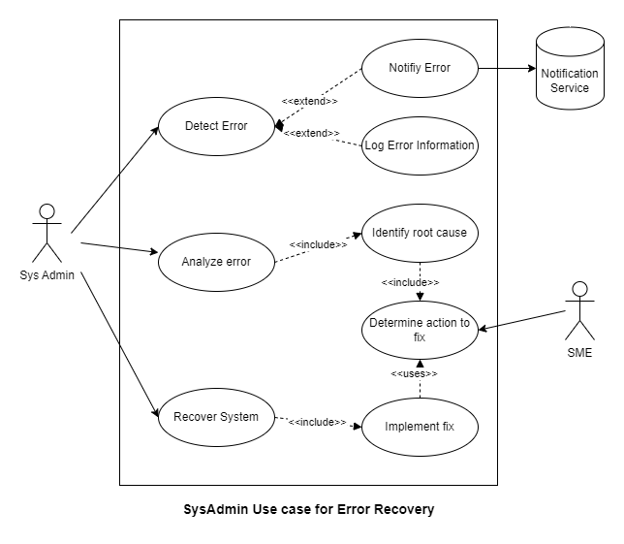
Error recovery

Slide 35
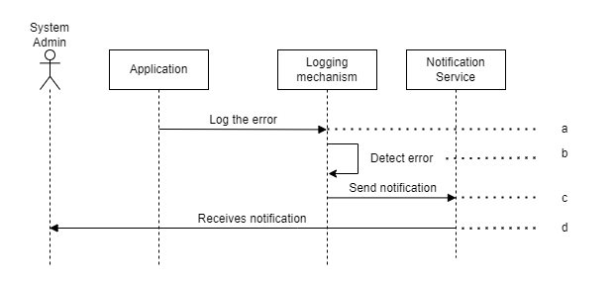
Detecting and logging of an error

Slide 36
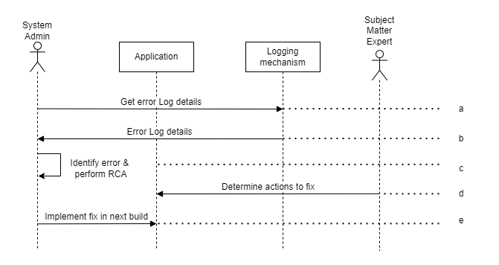
Implementing fix to an error

Slide 37
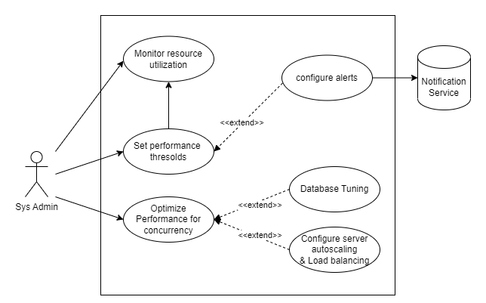
Application performance

Slide 38
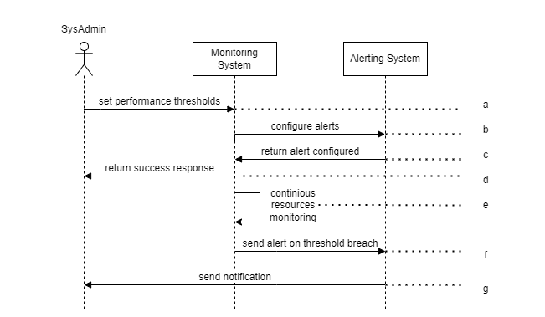
Resources monitoring and alerting

Slide 39
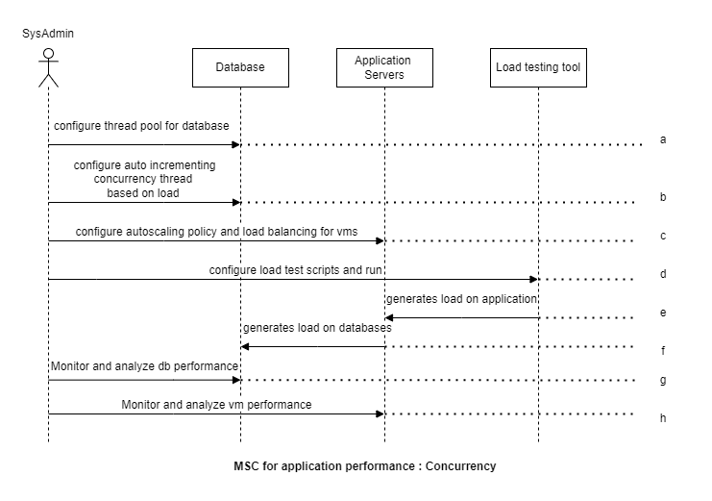
Concurrency for application performance

Slide 40
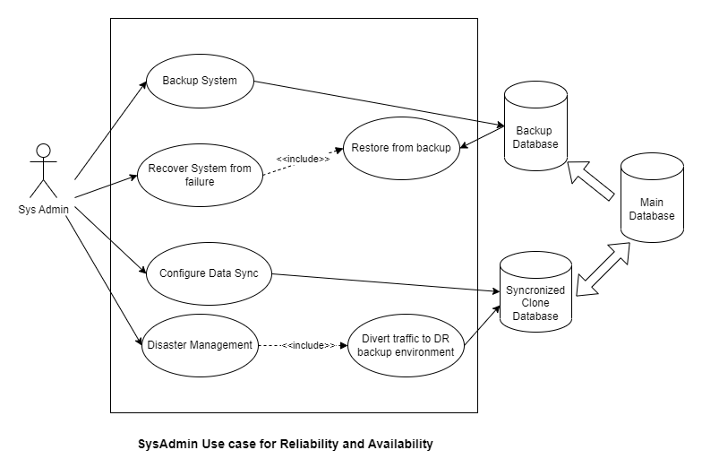
Reliability and Availability

Slide 41
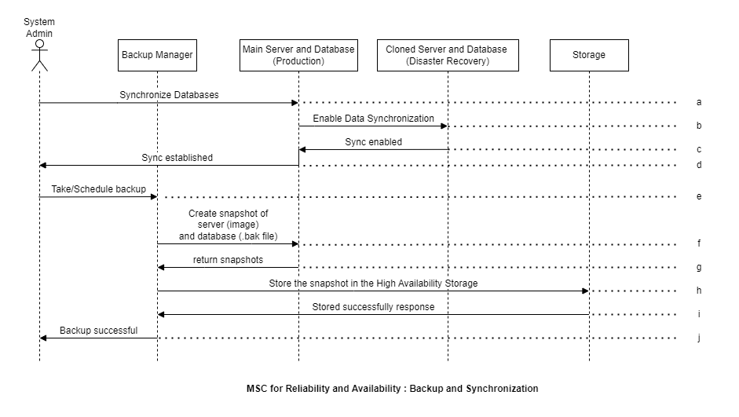
Data, server backup and synchronization

Slide 42
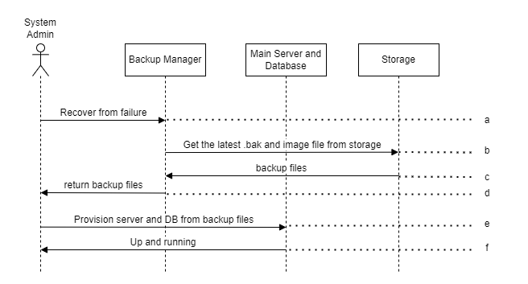
Recovery from failure

Slide 43
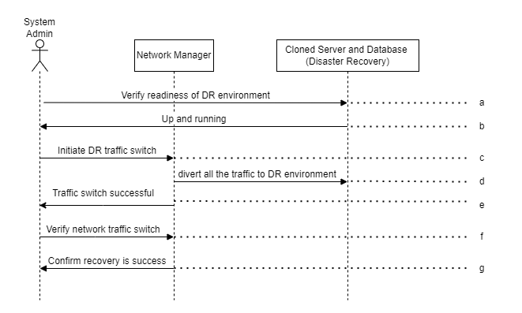
Disaster Recovery

Slide 44
Thank You

Slide 45
Appendix

Slide 46
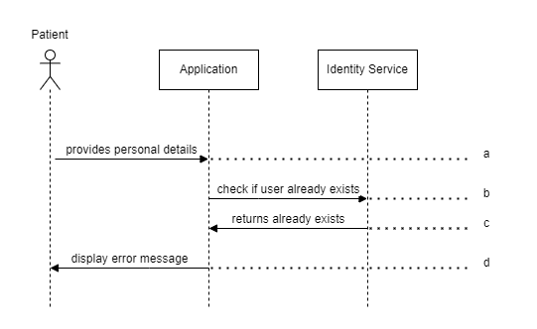
Existing user registration

Slide 47
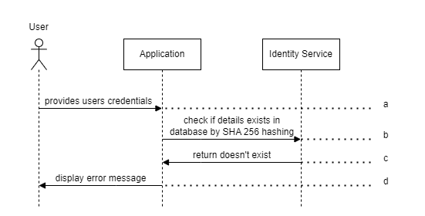
User entering wrong credentials

Slide 48
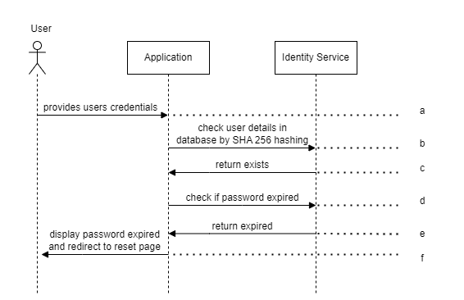
User password expiry

Slide 49
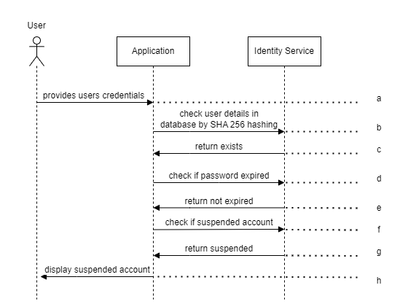
Suspended user login

Slide 50
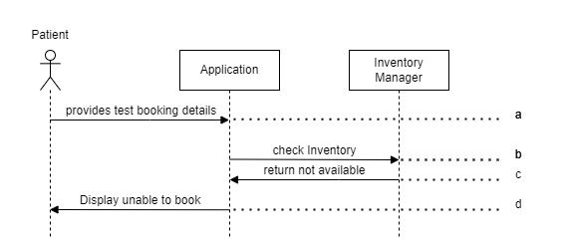
Booking failure due to unavailable inventory

Slide 51
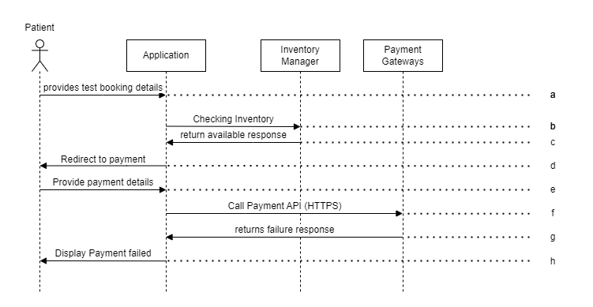
Payment failure for patient booking appointment online

Slide 52
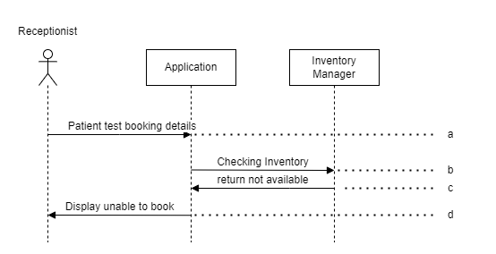
Booking failure due to unavailable inventory

Slide 53
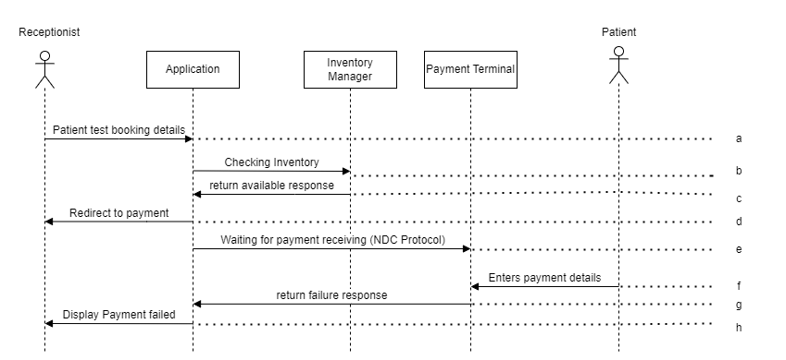
Payment failure in walk-in appointment

